Slide 1
TDI: Julia
Introduction to Programming and Julia
William Mui

Slide 2
Why we learn programming

Slide 3
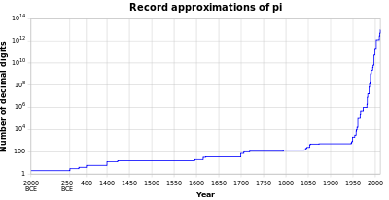
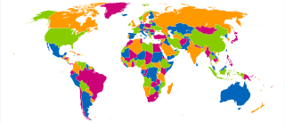
Assist in solving maths problems
Example:
Computing π(pi)
Four color theorem
Photo source: Wikipedia of pi and four color theorem

Slide 4
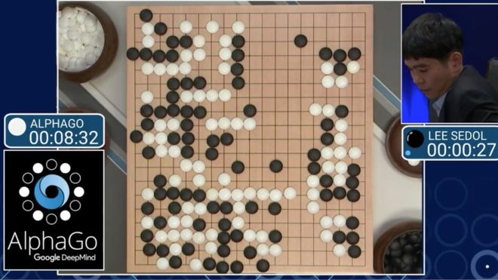
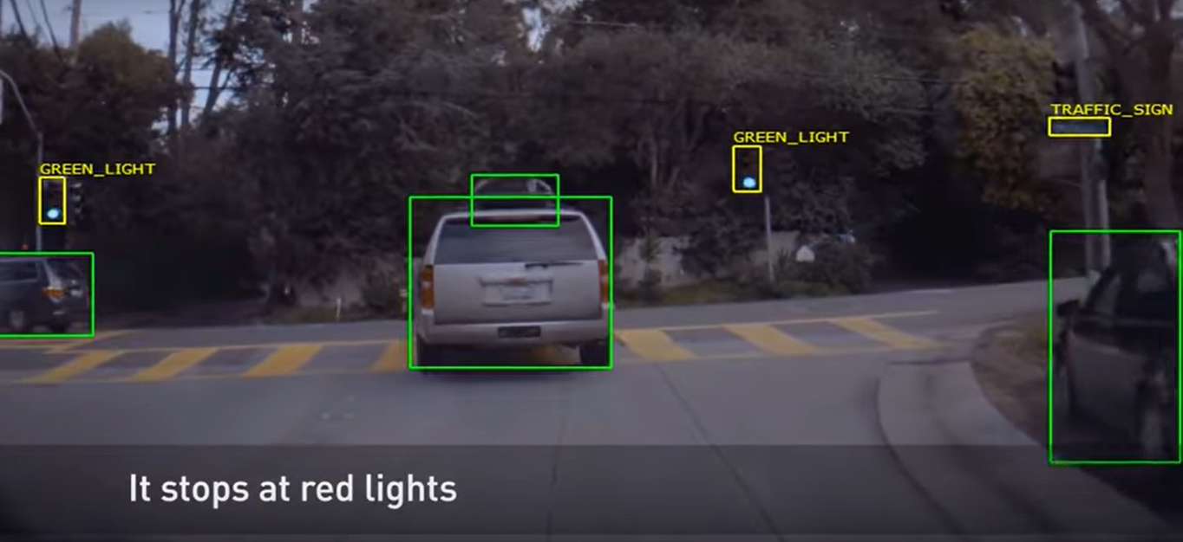
Artificial Intelligence (AI)
Example:
AlphaGo (Deep learning)
Self-Driving Car
Photo source: https://www.bbc.com/news/technology-35785875 https://www.youtube.com/watch?v=fmVWLr0X1Sk&feature=emb_title

Slide 5


Data Science
Example:
Healthcare (e.g. epidemiology)
Digital Advertisements
Photo source: https://scholar.harvard.edu/ctang/publications/big-data-epidemiological-research-overcoming-fear-%E2%80%9Cgarbage-garbage-out%E2%80%9D https://www.quora.com/What-is-digital-advertising

Slide 6
What is program

Slide 7
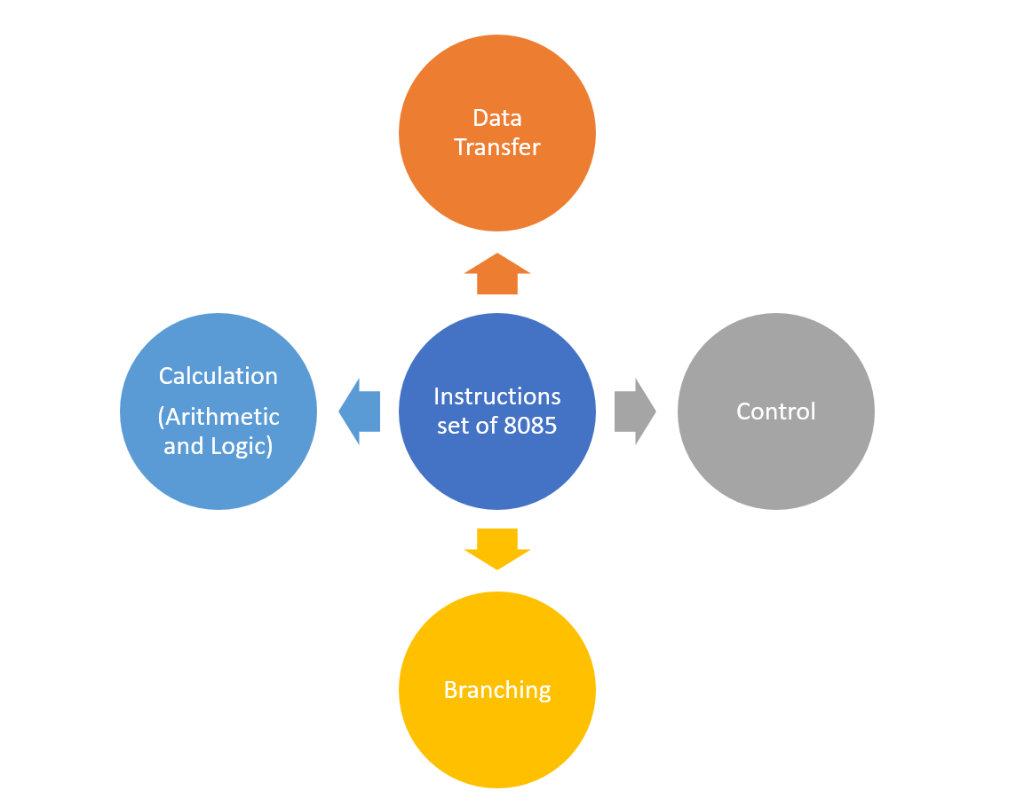
What is (Computer) Program?
Set of instruction (to hardware)
Executed by computer
Perform operation

Slide 8
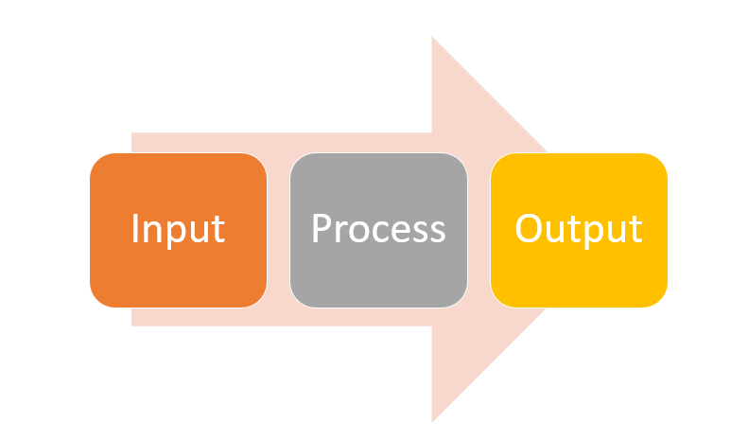
IPO model
Structure to describe the information process
Contains 3 steps
Input
Process
Output
Program is one of the examples follows IPO model

Slide 9
Concept of programming (language)

Slide 10
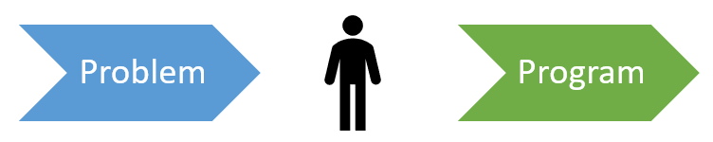
What is Programming
Process of designing and building a program
Including:
Analyzing
Coding
Testing
Debugging
Goal: Find the sequence of instructions to perform task on computer

Slide 11
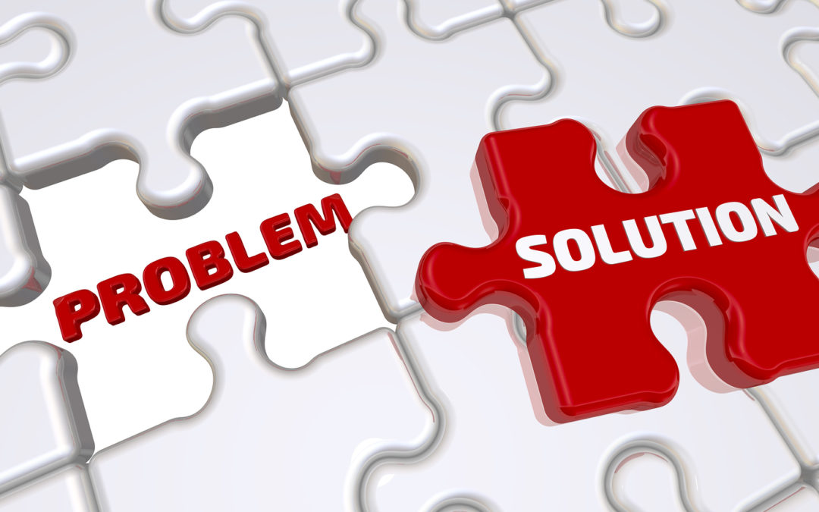
6-Steps for problem-solving
Problem Definition
Problem Analysis
Design of Algorithm
Implementation
Debugging and Testing
Documentation
Photo Source: https://www.skipprichard.com/7-steps-to-problem-solving/

Slide 12
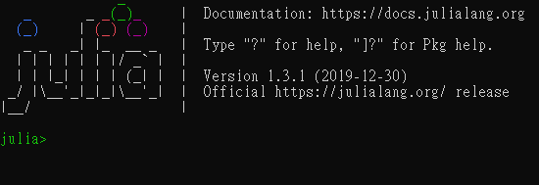
Programming Language
Programming language is set of
Vocabularies
Grammatical rules
To instructing the computer
Variant features for different languages

Slide 13
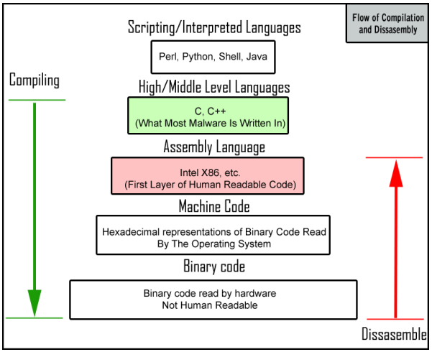
Programming Language
High-level languages
Designed to be used and understood by humans
Low-level language
Computer hardware can only understand
Machine Code
Photo Source: https://sherifelmahdi.wordpress.com/2012/02/

Slide 14
Why Julia

Slide 15

Why Julia
There are several reasons for learning Julia as the first programming language for data science.
Relatively high performance
Dynamically typed language
High-level syntax and easy to learn

Slide 16
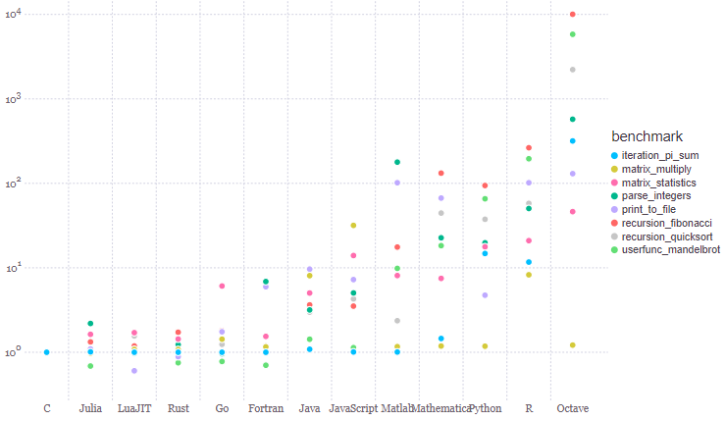
Performance
Photo source: https://nbviewer.jupyter.org/url/julialang.org/benchmarks/benchmarks.ipynb

Slide 17
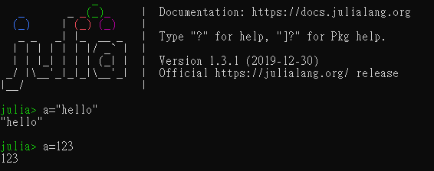
Dynamically typed Language
Static: Types checked before run-time
Need to define types of variables
Dynamic: Types checked on the fly, during execution
Not necessary to define types of variables
Side effect: misinterpreting and cause bugs

Slide 18
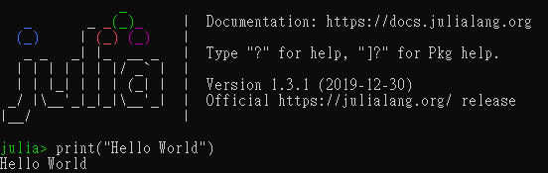
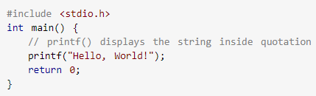
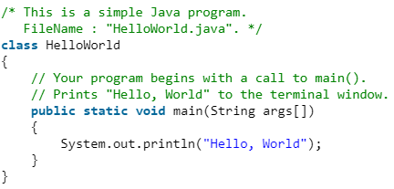
High-level syntax

Slide 19
Programming is one of the skills only

Slide 20
